Slide 1
Airbnb’s impact:
Is Airbnb impacting the real estate markets
of major U.S. cities?
Team 5 - Bob Chen, Sam Gass, Suer Hu, Miriam McKinney, Sindhi Polubothu
Apr 26, 2017

Slide 2
Outline
Main question
Data source information
Exploratory visualizations
Modelling results
Conclusion

Slide 3

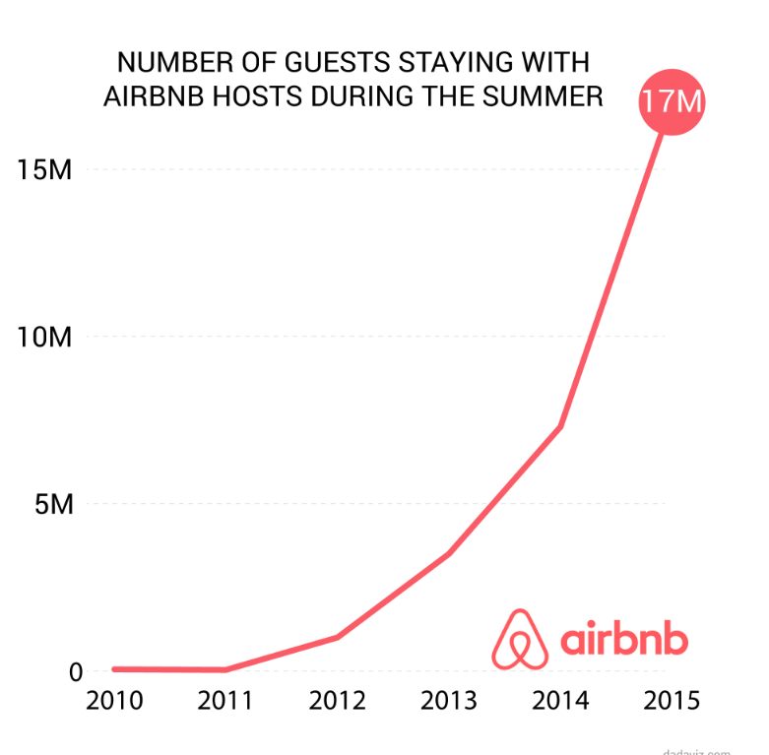


Has Airbnb impacted real estate markets over time?

Slide 4
Why is this important?
Can impact the average renter negatively
High rental units vs. rental supplement
Disrupts the hospitality industry

Slide 5


Data source information
Airbnb
Public Dataset using Occupancy or San Francisco model
Review Estimated bookings Occupancy %
Zillow
Zillow Rent Index (“ZRI”): Monthly median rent by neighborhoods (2010 - Present).
>50%
* length
Notes:
Airbnb
Dataset: Public information compiled from the Airbnb website including the availability calendar for 365 days in the future, and the reviews for each listing. Analysis suggests that spam reviews are small and do not affect the statistics. (Inside Airbnb, 2017).
Zillow
We created the Zillow Rent Index (ZRI) to track the monthly median rent in particular geographical regions. Like the ZHVI, we sought to create an index for rents that is unaffected by the mix of homes for rent at any particular time. This makes temporal comparisons of rents more valid since the index is tracking the rents for a consistent stock of inventory. It also makes it easier to compare the ZHVI and ZRI since they are based on a similar set of homes whereas traditional metrics tracking rent and sale prices are often based on markedly different sets of homes (often located in different neighborhoods), thus making comparisons less valid.
Within each county or state, the models observe recent rental listings and learn the relative contribution of various home attributes in predicting prevailing rents.These home attributes include physical facts about the home, prior sale transactions, tax assessment information and geographic location as well as the estimated market value of the home (Zestimate). Based on the patterns learned, these models estimate rental prices on all homes, including those not presently for rent. The purpose of the Rent Zestimate is to give consumers an indication of the fair market rent for a home, while the purpose of the ZRI is to give consumers insight into rental price trends in a way that is not biased by the mix of homes currently for rent.

Slide 6
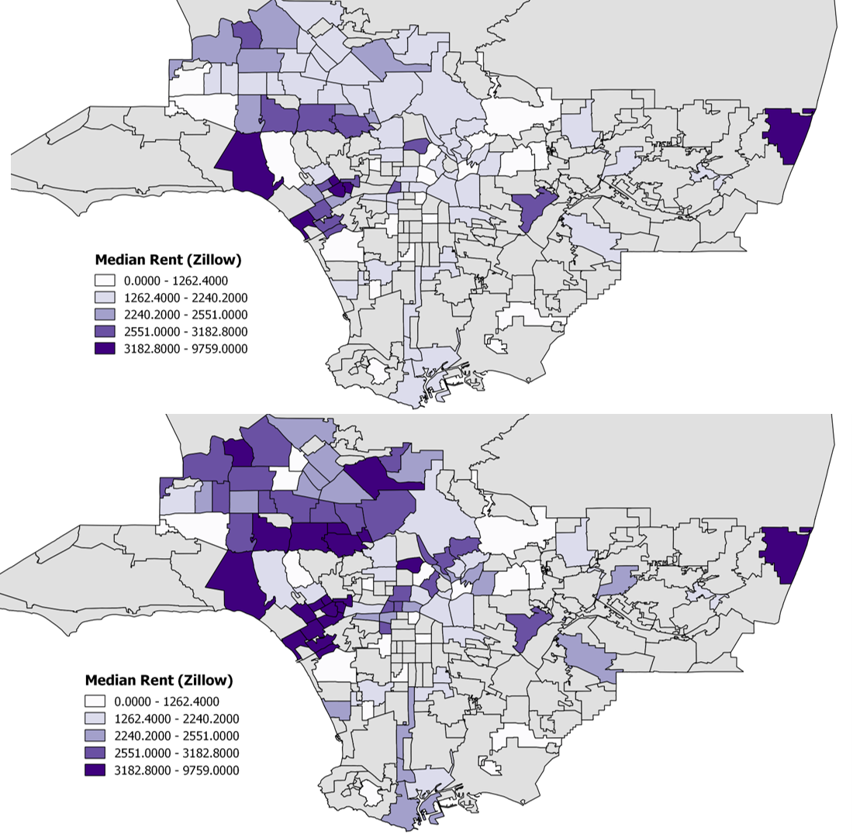
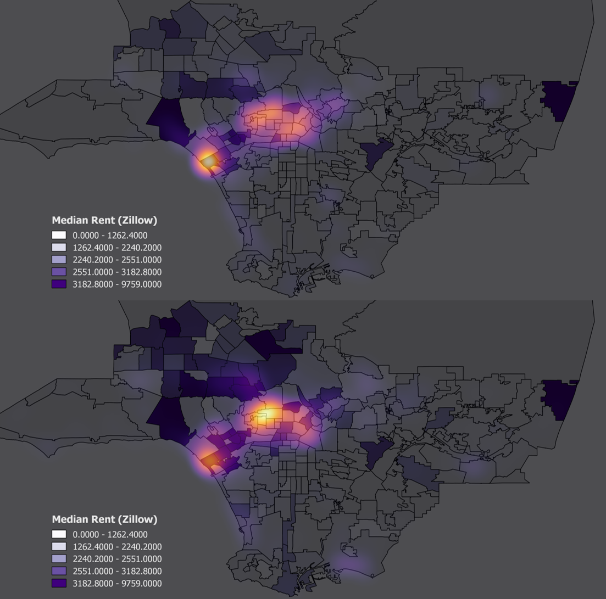
West Coast
Los Angeles
Dec 2012
Dec 2017

Slide 7
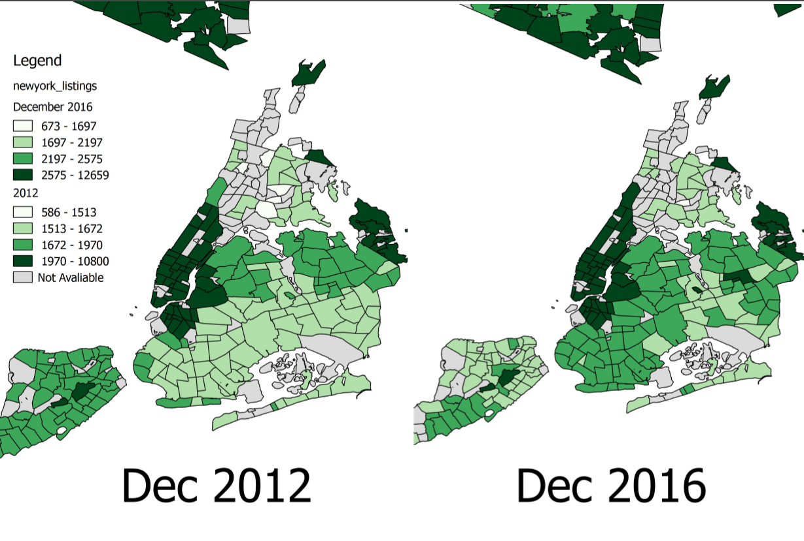
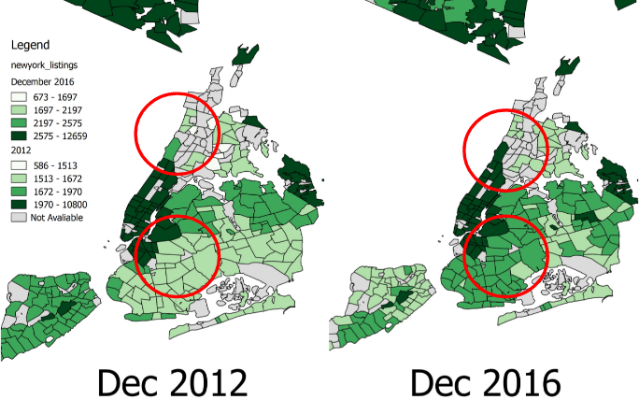
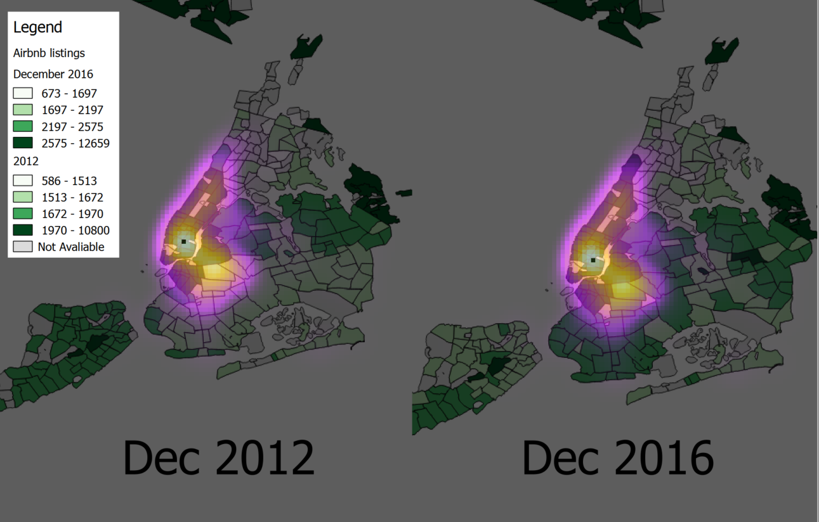
East Coast
East Coast
New York City

Slide 8
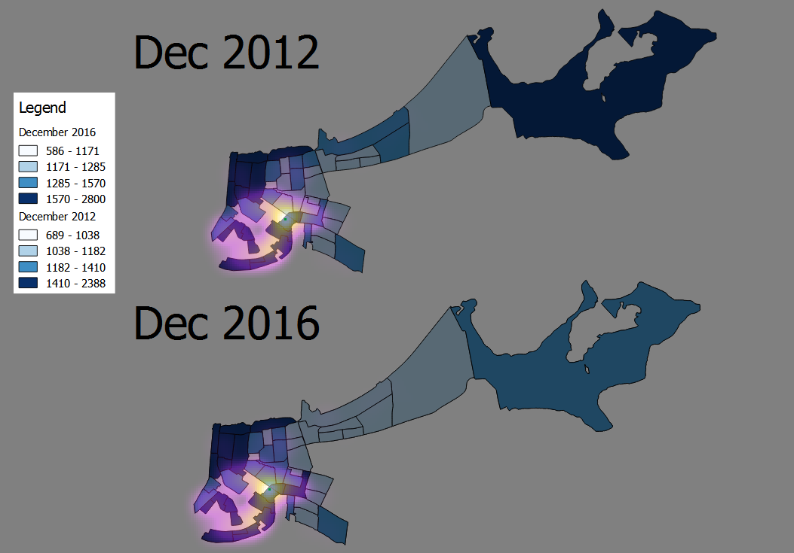
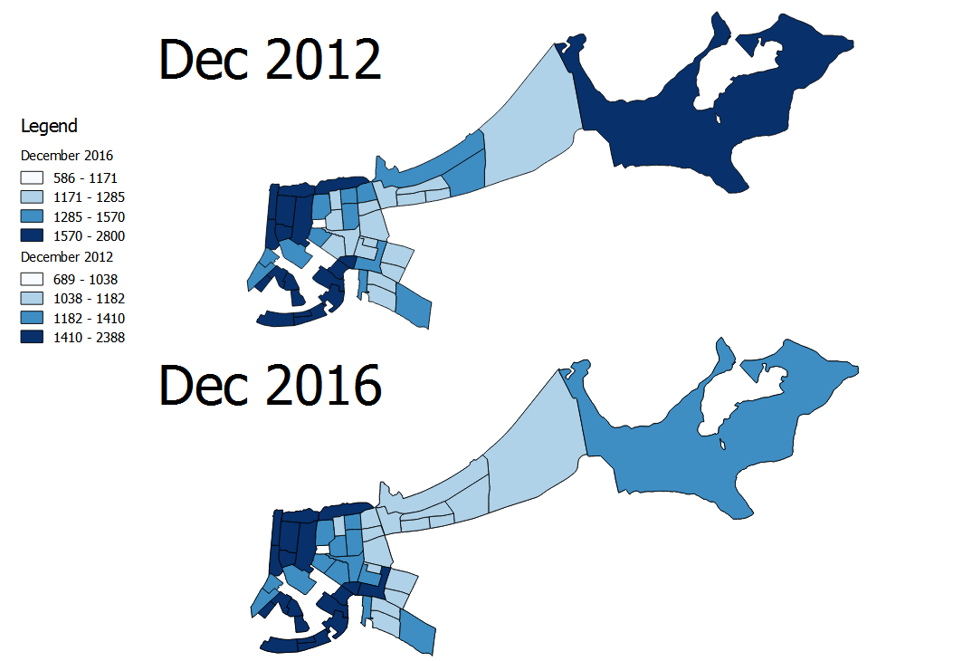
The South
New Orleans

Slide 9
The Fixed Effects Model: Data
Time series
2015 - 2016, by month
Dependent variable
Median rent for the neighborhood
Independent variables
Number of active Airbnb’s in neighborhood
Median rent for all properties in the neighborhood
Year fixed effects
Instrumental variable
Median rent for the whole city

Slide 10
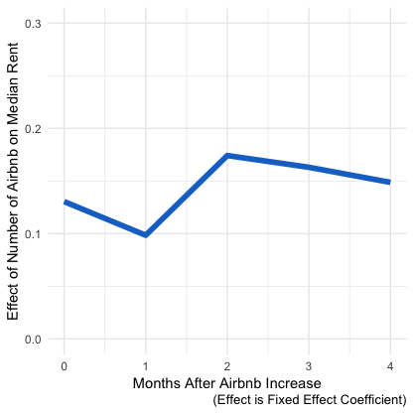
The Fixed Effect Model: Results
One additional Airbnb in neighborhood causes increase in ZRI(Rent)
Of .13 in Same Month
Of .09 one month Later
Of .17 two months Later
Of .16 three months Later
Of .14 four months Later
*Every coefficient is statistically significant

Slide 11

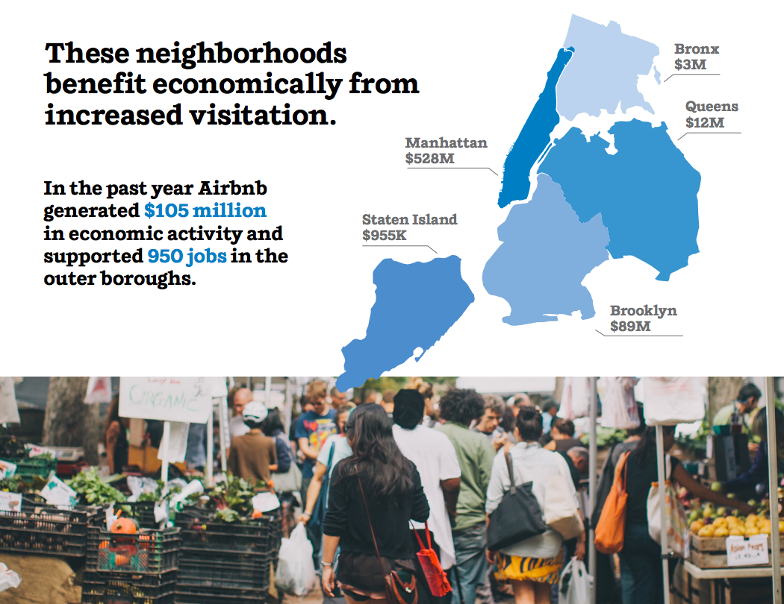
Positive impact on New York City (The Airbnb Blog)

Slide 12
Conclusion
Can also be seen as negative:
Real Estate Market
contributes to gentrification and shortage of supply
But can be seen as a positive entity:
Economy
invites tourists
Labor Market
creates new jobs
Income Equality
puts money in pockets of regular citizens
Rent Subsidy
Allows people to keep up with their rent by renting out extra room
Next Step: RISE
Recognize economic impact on housing communities worldwide
Increase charitable donations to community-based housing initiatives
Strengthen social bottom line by reaching out to urban planners in most affected areas
Encourage stakeholders to publicly support housing diversity and fair policy that mitigates rental displacement so that Airbnb remains a young, engaging and, importantly, positive brand

Slide 13
Thank you.
View our data and methods: https://github.com/SummerSue/Applied-Data-Science-Group-Repository

Slide 14
Appendix

Slide 15
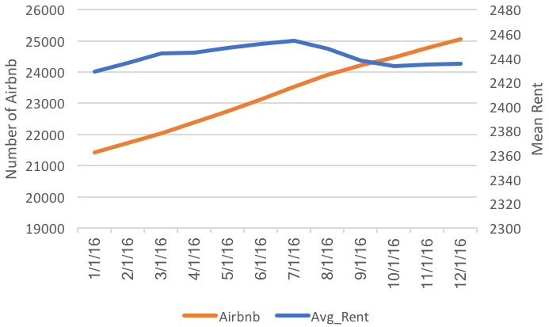
East Coast (New York City)

Slide 16
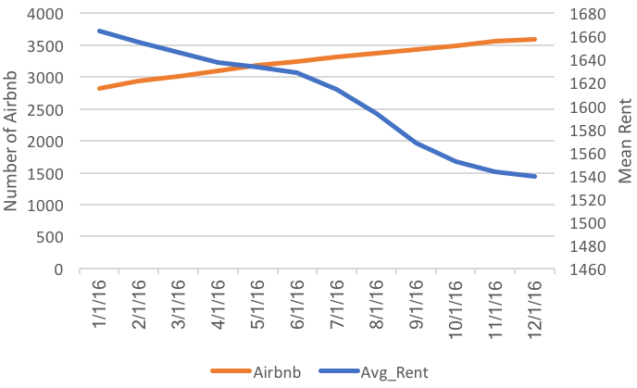
The South (New Orleans)

Slide 17
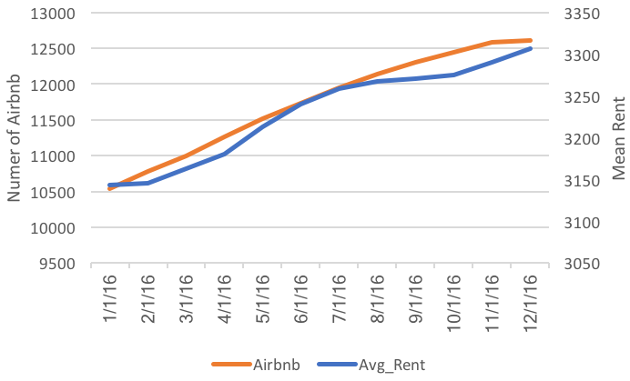
West Coast (Los Angeles)

Slide 18
West Coast

Slide 19
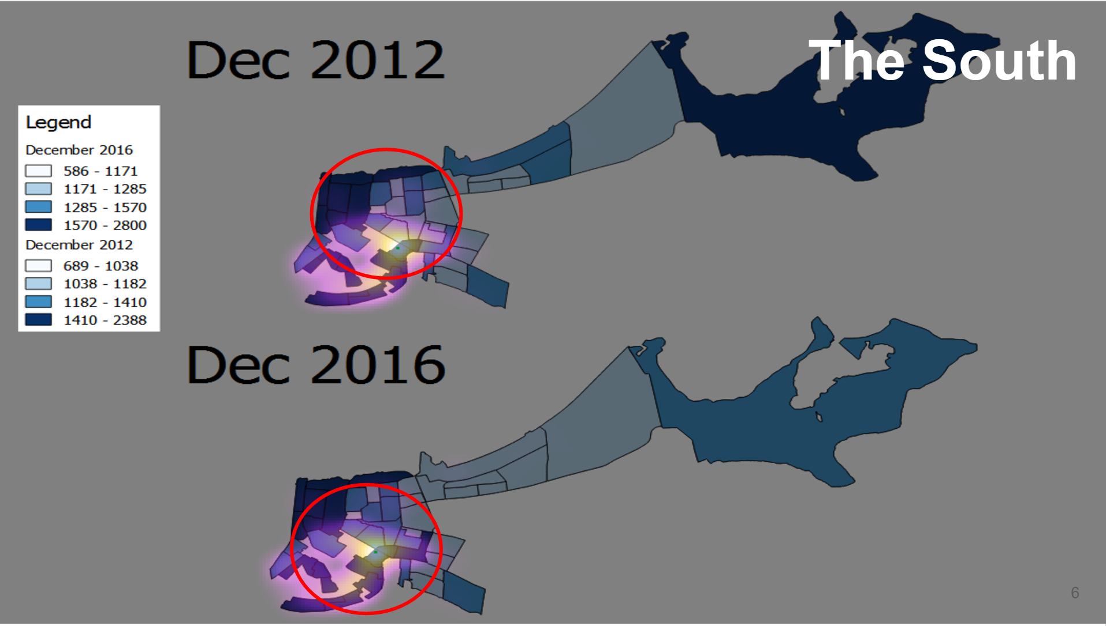
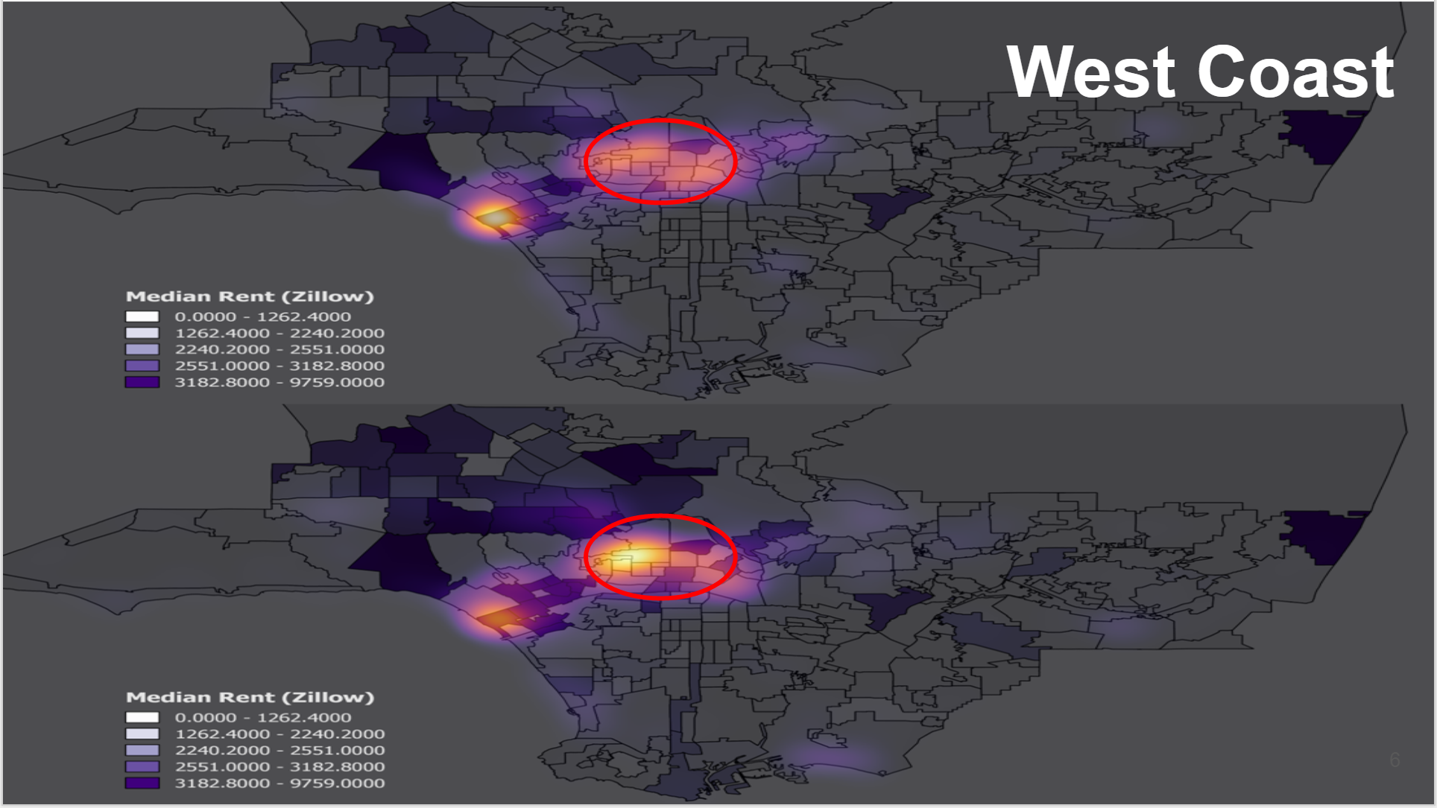
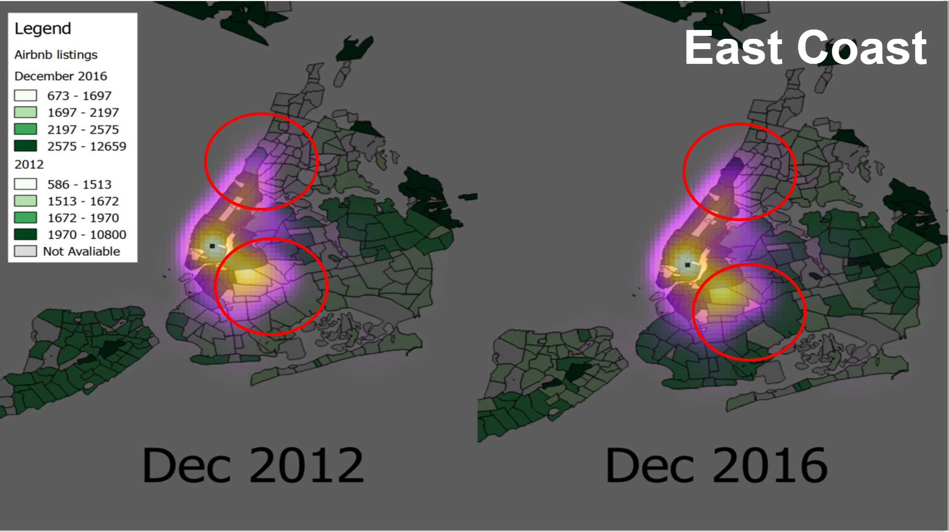
New York City

Slide 20
Fixed Effect No Lag
Balanced Panel: n=291, T=12, N=3492
Residuals :
Min. 1st Qu. Median 3rd Qu. Max.
-212.0000 -8.7400 -0.0429 9.5400 128.0000
Coefficients :
Estimate Std. Error t-value Pr(>|t|)
Airbnb 0.1304652 0.0253711 5.1423 2.878e-07 ***
ZRI_SFR_CONDO 0.7648441 0.0063546 120.3603 < 2.2e-16 ***
Date2016-02-01 2.0686049 1.7812315 1.1613 0.2455930
Date2016-03-01 1.7613518 1.7870658 0.9856 0.3243988
Date2016-04-01 1.9322327 1.7948435 1.0765 0.2817643
Date2016-05-01 3.1826535 1.8113848 1.7570 0.0790091 .
Date2016-06-01 4.9548189 1.8308476 2.7063 0.0068400 **
Date2016-07-01 4.8211272 1.8521952 2.6029 0.0092860 **
Date2016-08-01 1.7021473 1.8631438 0.9136 0.3610020
Date2016-09-01 -3.0168057 1.8697809 -1.6135 0.1067449
Date2016-10-01 -5.4978552 1.8795073 -2.9252 0.0034671 **
Date2016-11-01 -6.9938825 1.9022961 -3.6765 0.0002403 ***
Date2016-12-01 -8.3398657 1.9238823 -4.3349 1.503e-05 ***
---

Slide 21
Fixed Effect One Month Lag on ZR
Estimate Std. Error t-value Pr(>|t|)
bnb_lag1 29.9581 7.1339 4.1994 2.745e-05 ***
Date2016-03-01 -52.7094 34.4289 -1.5310 0.1258709
Date2016-04-01 -101.0685 41.2510 -2.4501 0.0143324 *
Date2016-05-01 -152.3095 51.9559 -2.9315 0.0033957 **
Date2016-06-01 -204.4804 64.1150 -3.1893 0.0014393 **
Date2016-07-01 -259.3478 76.7153 -3.3807 0.0007313 ***
Date2016-08-01 -325.6852 90.3269 -3.6056 0.0003159 ***
Date2016-09-01 -389.4405 102.7508 -3.7901 0.0001532 ***
Date2016-10-01 -440.2217 113.4956 -3.8788 0.0001070 ***
Date2016-11-01 -477.3034 122.7826 -3.8874 0.0001033 ***
Date2016-12-01 -518.2171 133.1588 -3.8917 0.0001014 ***
Signif. codes: 0 ‘***’ 0.001 ‘**’ 0.01 ‘*’ 0.05 ‘.’ 0.1 ‘ ’ 1
Total Sum of Squares: 9692000
Residual Sum of Squares: 562850000
R-Squared: 3.8727e-05
Adj. R-Squared: -0.10323
F-statistic: -302.786 on 11 and 3389 DF, p-value: 1

Slide 22
Fixed Effect With Two Month Lag on Airbnbs
Residuals :
Min. 1st Qu. Median 3rd Qu. Max.
-193.000 -7.780 -0.143 8.420 109.000
bnb_lag2 0.1741700 0.0288424 6.0387 1.775e-09 ***
Date2016-04-01 0.0074810 1.6284240 0.0046 0.9963349
Date2016-05-01 1.0266550 1.6376661 0.6269 0.5307788
Date2016-06-01 2.5548316 1.6529515 1.5456 0.1223182
Date2016-07-01 2.2146182 1.6718478 1.3247 0.1854023
Date2016-08-01 -1.0376817 1.6839374 -0.6162 0.5378008
Date2016-09-01 -5.8943737 1.6947667 -3.4780 0.0005135 ***
Date2016-10-01 -8.5428369 1.7095404 -4.9972 6.203e-07 ***
Date2016-11-01 -10.2457543 1.7350391 -5.9052 3.980e-09 ***
Date2016-12-01 -11.8112902 1.7612361 -6.7063 2.439e-11 ***
ZRI_SFR_CONDO 0.7781698 0.0067229 115.7491 < 2.2e-16 ***
Total Sum of Squares: 6629600
Residual Sum of Squares: 1003900
R-Squared: 0.84858
Adj. R-Squared: 0.8311
F-statistic: 1328.68 on 11 and 2608 DF, p-value: < 2.22e-16

Slide 23
Fixed Effect Three Month Lag on ZR
Residuals :
Min. 1st Qu. Median 3rd Qu. Max.
-189.000 -7.410 -0.183 7.920 116.000
Coefficients :
Estimate Std. Error t-value Pr(>|t|)
bnb_lag3 0.1630477 0.0313000 5.2092 2.064e-07 ***
Date2016-05-01 0.9443596 1.5525830 0.6083 0.5430808
Date2016-06-01 2.4930377 1.5648448 1.5932 0.1112621
Date2016-07-01 2.1246052 1.5829740 1.3422 0.1796754
Date2016-08-01 -1.1023423 1.5947824 -0.6912 0.4894978
Date2016-09-01 -5.9202343 1.6056943 -3.6870 0.0002321 ***
Date2016-10-01 -8.5910081 1.6231983 -5.2926 1.319e-07 ***
Date2016-11-01 -10.3609944 1.6531802 -6.2673 4.366e-10 ***
Date2016-12-01 -11.9955051 1.6848108 -7.1198 1.436e-12 ***
ZRI_SFR_CONDO 0.7829548 0.0071889 108.9123 < 2.2e-16 ***
---
Signif. codes: 0 ‘***’ 0.001 ‘**’ 0.01 ‘*’ 0.05 ‘.’ 0.1 ‘ ’ 1
Total Sum of Squares: 5220500
Residual Sum of Squares: 807570
R-Squared: 0.84531
Adj. R-Squared: 0.82529
F-statistic: 1266.66 on 10 and 2318 DF, p-value: < 2.22e-16

Slide 24
Fixed Effect With Four Month Lag on Airbnbs
Residuals :
Min. 1st Qu. Median 3rd Qu. Max.
-188.000 -7.090 -0.109 7.460 86.500
Coefficients :
Estimate Std. Error t-value Pr(>|t|)
bnb_lag4 0.1487018 0.0342932 4.3362 1.521e-05 ***
Date2016-06-01 1.6221113 1.4482822 1.1200 0.2628
Date2016-07-01 1.3910069 1.4609116 0.9521 0.3411
Date2016-08-01 -1.8041786 1.4716740 -1.2259 0.2204
Date2016-09-01 -6.5955947 1.4825024 -4.4490 9.096e-06 ***
Date2016-10-01 -9.2227328 1.5000829 -6.1481 9.415e-10 ***
Date2016-11-01 -10.9459422 1.5327441 -7.1414 1.282e-12 ***
Date2016-12-01 -12.5427426 1.5693930 -7.9921 2.205e-15 ***
ZRI_SFR_CONDO 0.7767110 0.0079451 97.7600 < 2.2e-16 ***
---
Signif. codes: 0 ‘***’ 0.001 ‘**’ 0.01 ‘*’ 0.05 ‘.’ 0.1 ‘ ’ 1
Total Sum of Squares: 3638600
Residual Sum of Squares: 614530
R-Squared: 0.83111
Adj. R-Squared: 0.8062
F-statistic: 1108.83 on 9 and 2028 DF, p-value: < 2.22e-16

Slide 25
West Coast
Los Angeles
(Airbnb density heatmap)
Dec 2012
Dec 2016

Slide 26
East Coast
New York City Zillow data with Airbnb density

Slide 27
The South
New Orleans City Zillow data

Slide 28
The South
New Orleans City Zillow data with Airbnb density

